Slide 1
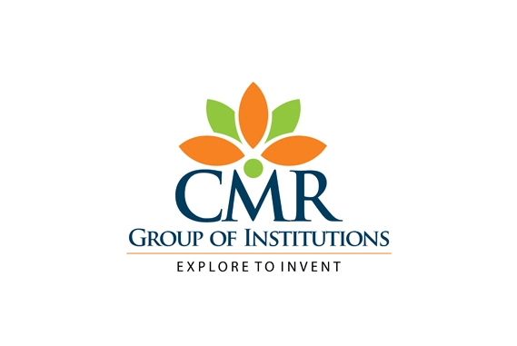

MAJOR PROJECT
ON
ANDRO DOCTOR
CMR TECHNICAL CAMPUS
UGC AUTONOMOUS
Accredited by NBA & NAAC with A Grade
Approved by AICTE, New Delhi and Affiliated to JNTU, Hyderabad
DEPARTMENT OF COMPUTER SCIENCE AND ENGINEERING
PRESENTED BY:
SAI KEERTHANA T (197R1A05A4)
MATHEW PRABHAKAR (207R5A0510)
ASRITHA VENKATA KAMALA(197R1A05B0)
UNDER THE GUIDANCE
OF
Dr PRABHU A
(Associate Professor)

Slide 2
INTRODUCTION AND OVERVIEW OF THE PROJECT
Medical records is one of the most important aspect for a patient treatment. It is useful for the doctors to study the patients health history and provide better treatment for each individual.
It could be considered as a medical management, family healthcare, medical records tracker app as normal persons can use the app to store their private medical information and their family health history, thus making it easy for your doctor to track your medical info history.
Period Tracker logs your dates and calculates the average of your past menstrual cycles to predict the start date of your next period.
Human skin is one amongst the foremost unpredictable and tough terrains to mechanically synthesize and analyse because of its quality of unevenness, tone, presence of hair and alternative mitigating options.

Slide 3
Diabetes is rapidly growing nowadays in individuals, particularly young people and become a major challenge for the researcher, scientist and educationist.
The main reason of diabetes is increase in the amount of sugar in the blood.
Many people suffer from scalp hair problems such as dandruff, folliculitis, hair loss, and oily hair due to poor daily habits, imbalanced nutritional intake, high stress, and toxic substances in their environment.
To treat these scalp problems, dedicated services such as scalp hair physiotherapy have emerged in recent years.
This app proposes a deep learning-based intelligent scalp inspection and diagnosis system.

Slide 4
EXISTING SYSTEM
There are some existing applications for managing the medical records. You can use it to store the data and retrieve it when it is necessary. It will also work as a tracker and analyze the key information.
Unfortunately, there are no applications which track both men and women's health. Women's menstrual tracking systems exist in individual applications but complete tracking of a women’s health data is neglected.
There are some existing systems regarding predicting the skin disease which are implemented using Machine Learning algorithms like ANN,BPN and SVM where the accuracy are 80%,75-80% respectively.
Predicting the Diabetes using Machine Learning algorithms like KNN,SVM,Decision Tree,Logistic Regression, Random Forest algorithms which produces accuracy less than 70%.

Slide 5
DISADVANTAGES
There is no single application which can track men and women health separately.
Complete tracking of women’s health including menstrual cycle is not available.
In case of analysing the blood glucose levels and blood pressure levels,data needs to be entered manually.
The existing system Machine Learning algorithms are not accurate to predict best results for various skin diseases and diabetes.

Slide 6
PROPOSED SYSTEM
In this application we intend to examine a person’s complete health. This is an application which can store and retrieve the data when necessary and it can be considered as medical management and history tracker app.
Women can check their monthly period cycles and fertile days which will be updated regularly.
The proposed approach is based on the pre-processing, Deep learning algorithm, training the model , validation and classification phase.
Experiments were performed on various images of skin diseases and 93% accuracy is achieved using Convolutional Neural Networks (CNN).
The proposed method approach for diabetes prediction is CNN algorithm based on deep learning system and highest accuracy is achieved.
To treat these scalp problems, dedicated services such as scalp hair physiotherapy have emerged in recent years. This app proposes a deep learning-based intelligent scalp inspection and diagnosis system.

Slide 7
ADVANTAGES
Management of the medical records will be easy.
Women can track their monthly periods.
Patient records will be stored at one place.
Paper maintenance will be reduced.
The application reminds the users regarding the period cycle of women.
The prediction of skin diseases and diabetes produces the best accurate results.

Slide 8
SYSTEM REQUIREMENTS
HARDWARE REQUIREMENTS
System : Intel Core i5.
Hard Disk : 1 TB.
Monitor : 15’’ LED
Input Devices : Keyboard, Mouse
RAM : 8 GB.
PROCESSOR :13/Intel Processor
SOFTWARE REQUIREMENTS
Operating System: Windows 8/10/11
Development Software: Android Studio,PyCharm
Database: Firebase

Slide 9
NOVELTY
The novelty of this project centers on the application collecting complete data of men and women wherein, both men and women can store all the medical documents which includes medical health checkups, blood reports, doctor's prescription,laboratory data, reports of diagnostic evaluations, pharmacy records, and billing processes etc.
The special feature for women is they can track their monthly period cycles and will be notified before the cycle start.
A novel system is presented where there are No single application integrated with Machine Learning predicting Multiple diseases.

Slide 10
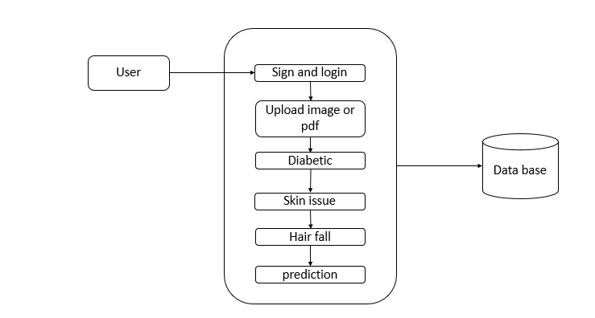
ARCHITECTURE

Slide 11
USE CASE DIAGRAM

Slide 12
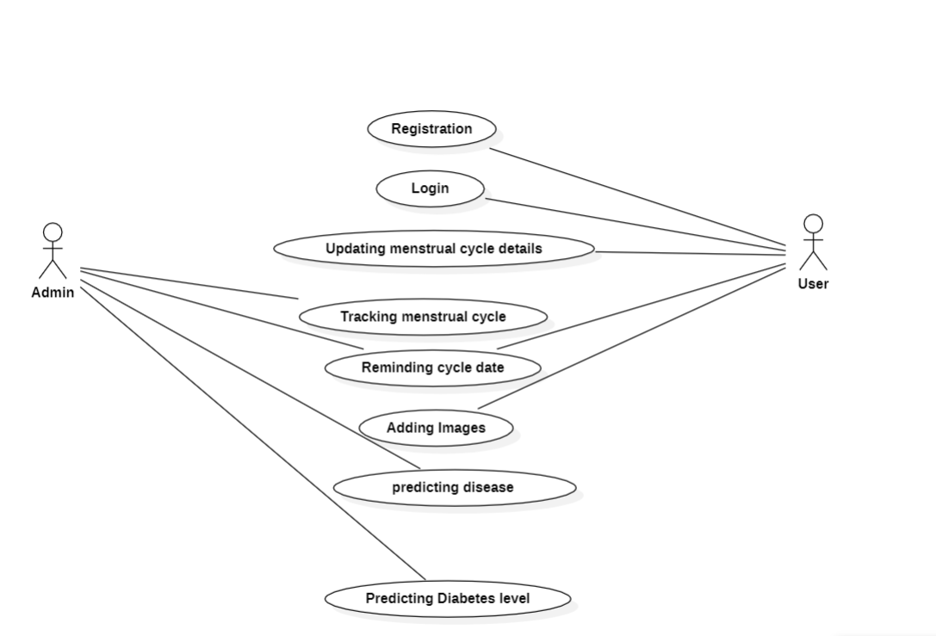

Slide 13
CLASS DIAGRAM

Slide 14
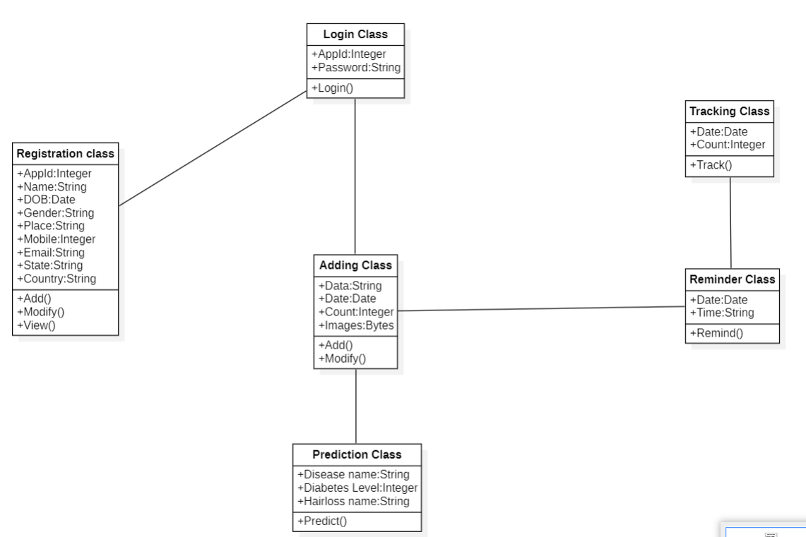

Slide 15
SEQUENCE DIAGRAM

Slide 16
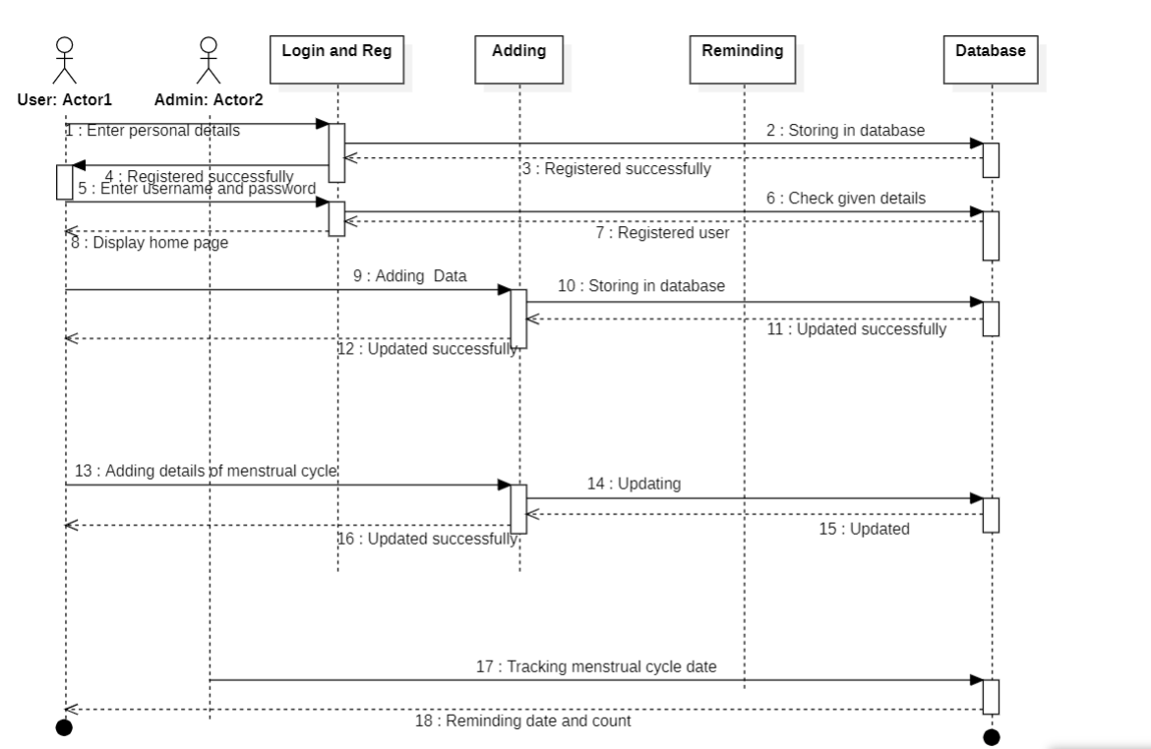

Slide 17
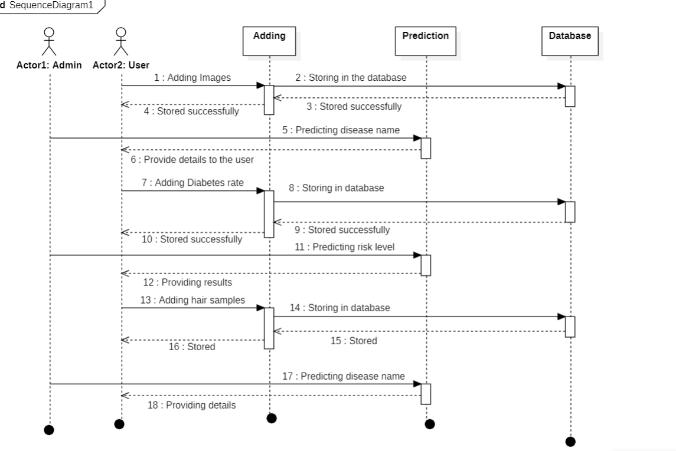

Slide 18
ACTIVITY DIAGRAM

Slide 19
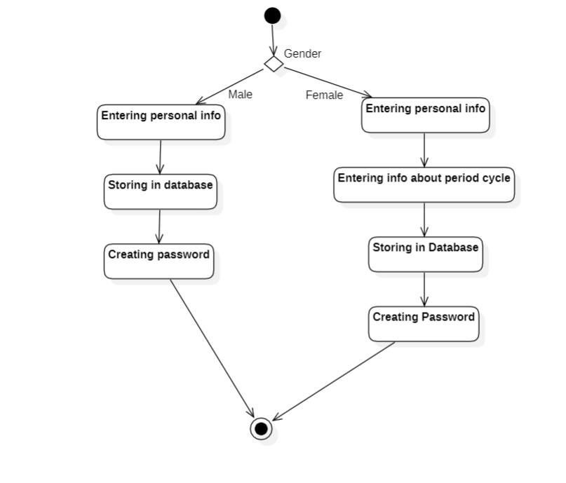

Slide 20
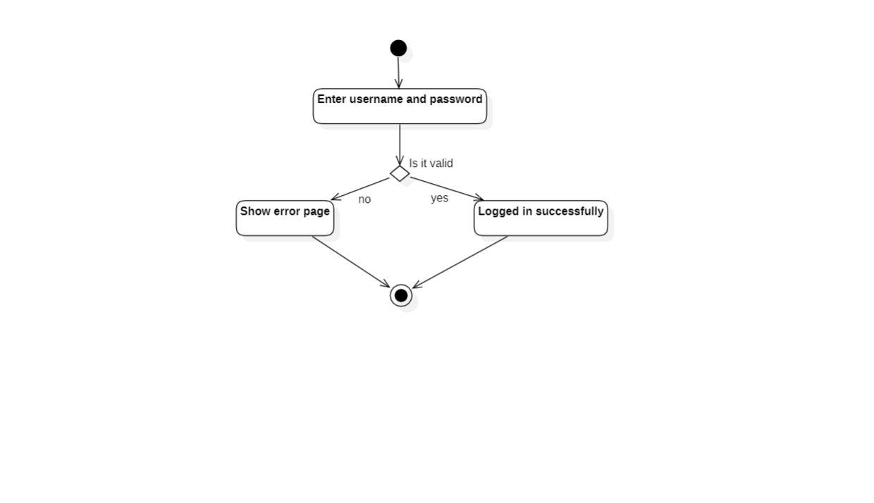

Slide 21
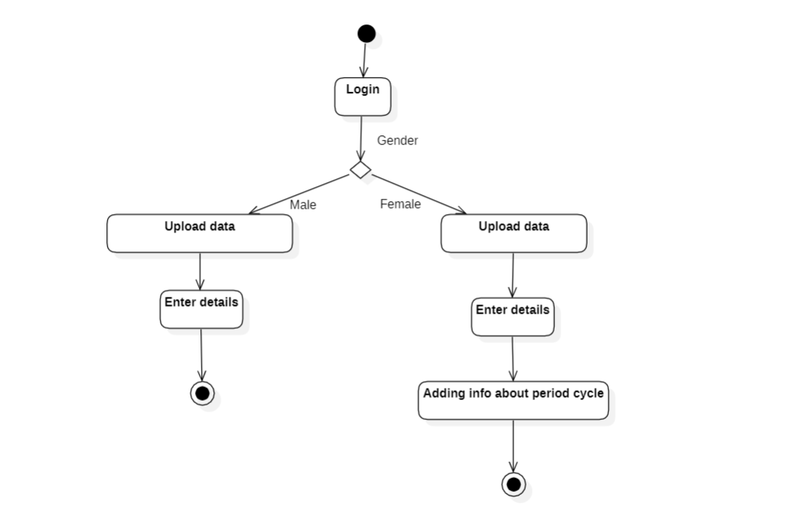

Slide 22
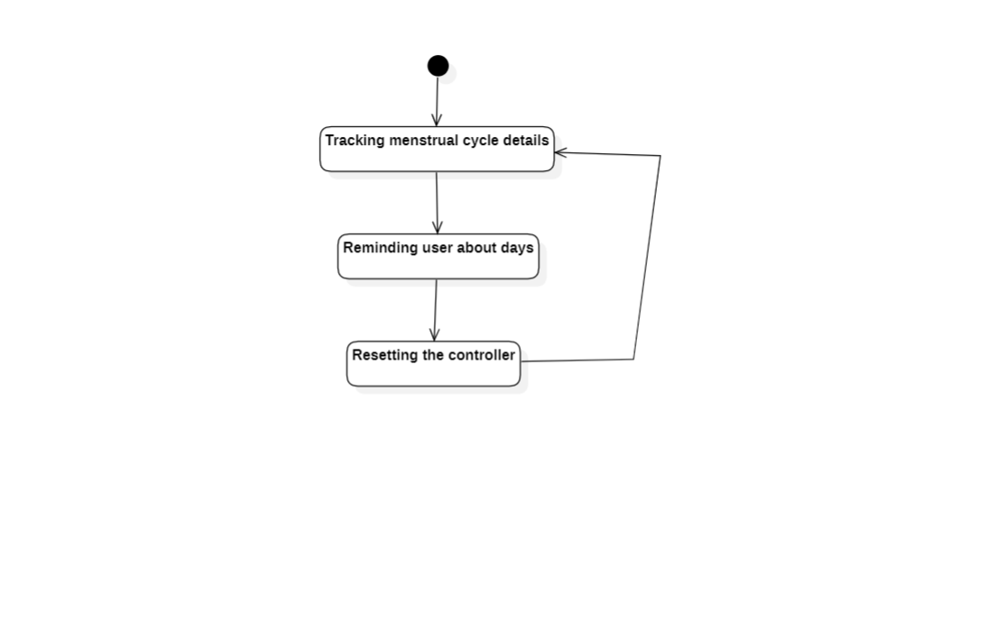

Slide 23
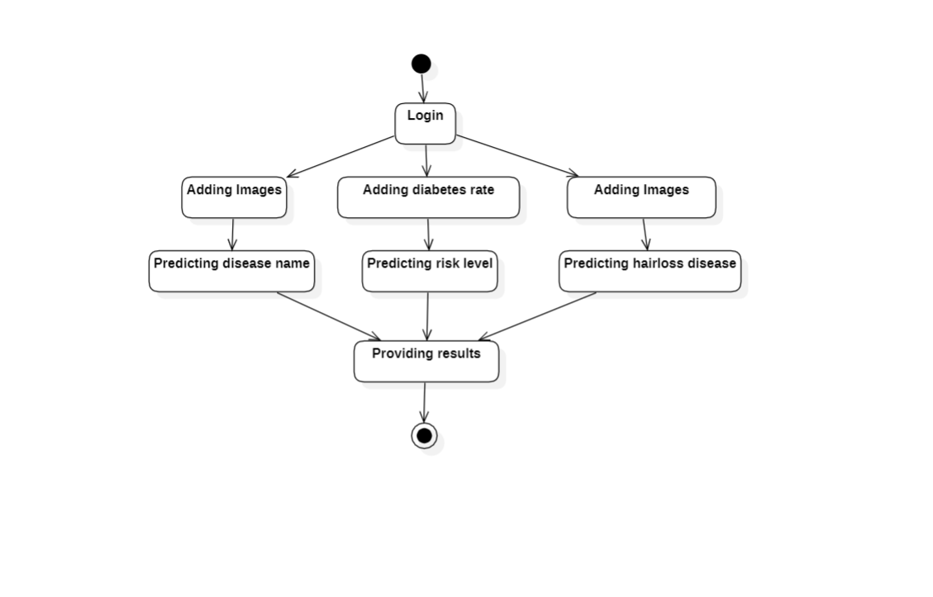

Slide 24
LITERATURE SURVEY

Slide 25
1.Skin Disease Detection and Classification
Mritunjay Kumar Ojha; Dilrose Reji Karakattil; Akshat Devendra Sharma; Sneha Mary Bency
Skin being the outermost integument of the human body has a significant role when it comes to protecting our body from sunlight, cold and other harmful germs and substances. Hence it is highly necessary to detect and properly diagnose skin disease in the early stages to avoid spread of the disease.Our project involves image processing and classification of skin diseases using image data. These have been implemented with the help of two classifiers such as Convolutional Neural Networks and Mobile Net in the domain of Deep Learning. Therefore, this project is an early warning tool which informs users about skin diseases that they are suffering from using a computer aided method.

Slide 26
2.ScalpEye: A Deep Learning-Based Scalp Hair Inspection and Diagnosis System for Scalp Health
Wan-Jung Chang Liang-Bi Chen Ming-Che Chen Yi-Chan Chiu and Jian-Yu Lin
Many people suffer from scalp hair problems such as dandruff, folliculitis, hair loss, and oily hair due to poor daily habits, imbalanced nutritional intake, high stress, and toxic substances in their environment. To treat these scalp problems, dedicated services such as scalp hair physiotherapy have emerged in recent years. This article proposes a deep learning-based intelligent scalp inspection and diagnosis system, named ScalpEye, as an efficient inspection and diagnosis system for scalp hair physiotherapy as part of scalp healthcare. The proposed ScalpEye system consists of a portable scalp hair imaging microscope, a mobile device app, a cloud-based artificial intelligence (AI) training server, and a cloud-based management platform. In this study, we tested several popular object detection models and adopted a Faster R-CNN with the Inception ResNet_v2_Atrous model in the ScalpEye system for image recognition when inspecting and diagnosing scalp hair symptoms.

Slide 27
3.Diabetes Prediction Using Different Machine Learning Approaches
Priyanka Sonar; K. Jaya Malini
The diabetes is one of lethal diseases in the world. It is additional a inventor of various varieties of disorders foe example: coronary failure, blindness, urinary organ diseases etc. In such case the patient is required to visit a diagnostic center, to get their reports after consultation. Due to every time they have to invest their time and currency. But with the growth of Machine Learning methods we have got the flexibility to search out an answer to the current issue, we have got advanced system mistreatment information processing that has the ability to forecast whether the patient has polygenic illness or not. The aim of this analysis is to develop a system which might predict the diabetic risk level of a patient with a better accuracy. Model development is based on categorization methods as Decision Tree, ANN, Naive Bayes and SVM algorithms.

Slide 28
4.Face Skin Disease Detection with Textural Feature Extraction
Anita Ahmad Kasim, Wirdayanti, Irwan Mahmudi
This study aims to build a model for the detection of facial skin diseases by utilizing the texture features in digital images of facial skin. The model is an automatic initial screening system for facial skin that can be used before carrying out further diagnosis processes by utilizing relatively expensive medical technology. Characteristics in facial images are obtained by extracting the textural features of the face digital image. Texture characteristics will distinguish the class of each facial problem based on their respective severity. The method used to extract textural features is the Gray Level Co-Occurrence Matrices (GLCM) method with the K-Nearest Neighbor classification method. The facial image data used were 150 digital images of problematic faces which were divided into 70% training data and 30% test data.

Slide 29
AUTHOR | TITLE | ALGORITHM | DRAWBACKS
Mritunjay Kumar Ojha, Dilrose Reji Karakattil, Akshat Devendra Sharma,Sneha Mary Bency | Skin Disease Detection And Classification | Convolutional Neural Network(CNN),MobileNet in Deep Learning | Small architecture Unpredictable results
Wan-Jung Chan, Liang-Bi Chen,Ming-Che Chen,Yi-Chan Chiu and Jian-Yu Lin | Scalp-Eye: A Deep Learning Based Scalp Hair Inspection and Diagnosis System For Scalp Health | Regions with convolutional neural networks(R-CNN) | - Even though better algorithm is used yet results are with less accuracy.
Priyanka Sonar, K. Jaya Malini | Diabetes Prediction Using Different Machine Learning Approaches | Decision Tree, Artificial Neural Network(ANN), Naive Bayes, Support Vector Machine(SVM) | Low accuracy Less precision Requires huge processing time
Anita Ahmad Kasim, Wirdayanti, Irwan Mahmudi | Face Skin Disease Detection With Textural Feature Extraction | K-Nearest Neighbour(KNN) | - Cannot handle large data

Slide 30
SCREENSHOTS

Slide 31
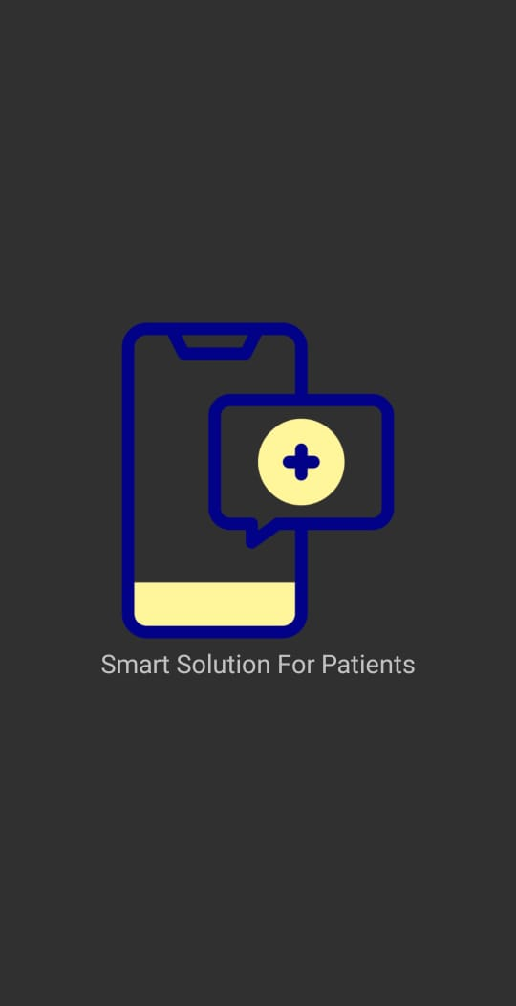
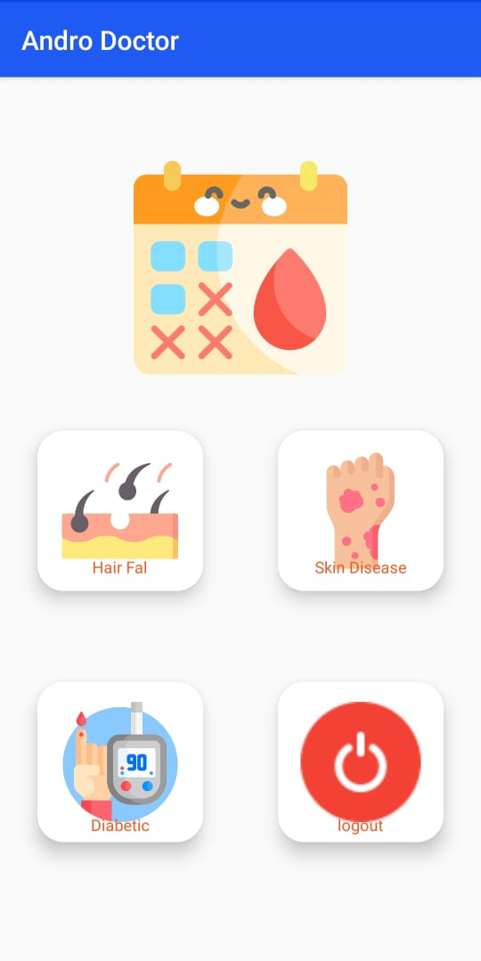

Slide 32
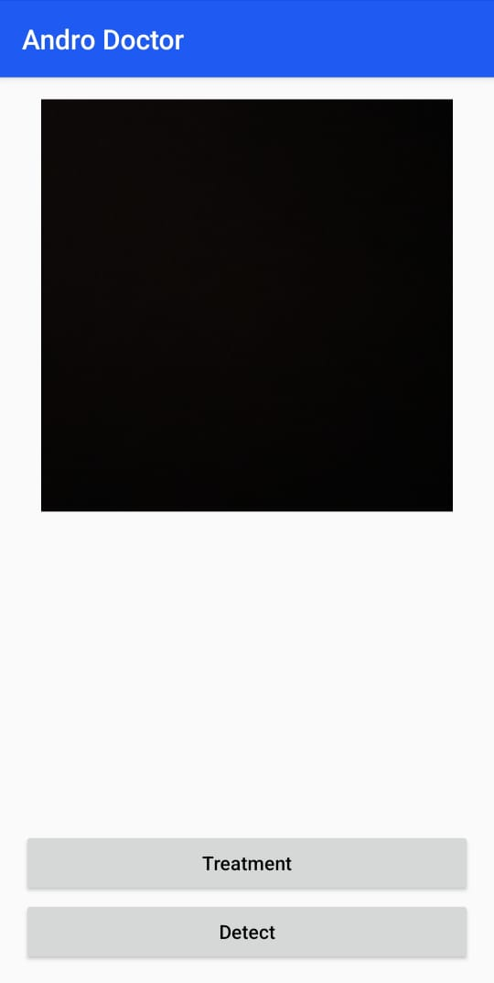
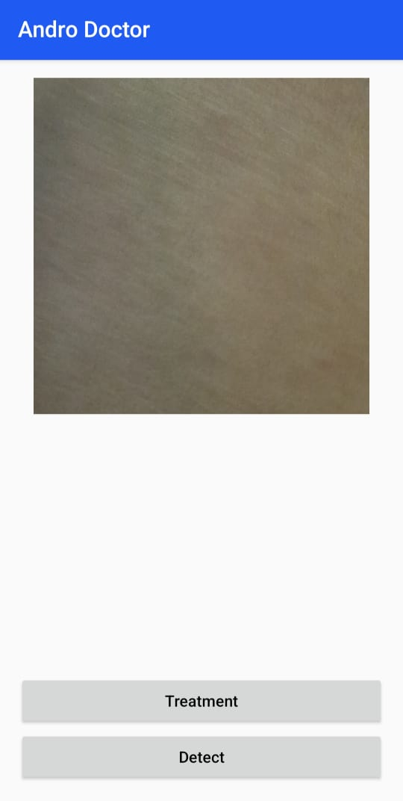
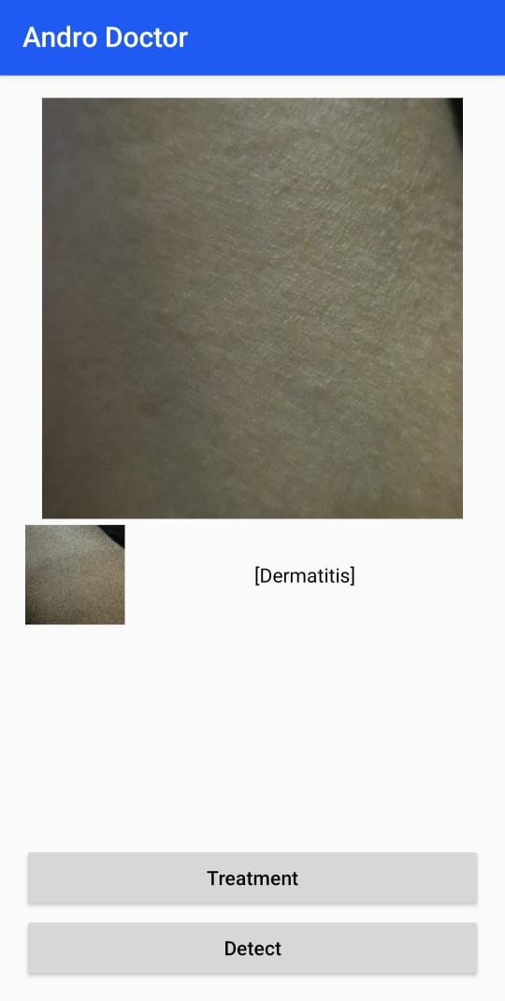

Slide 33
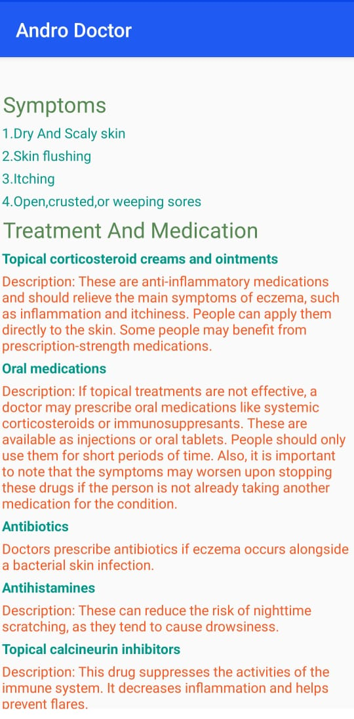
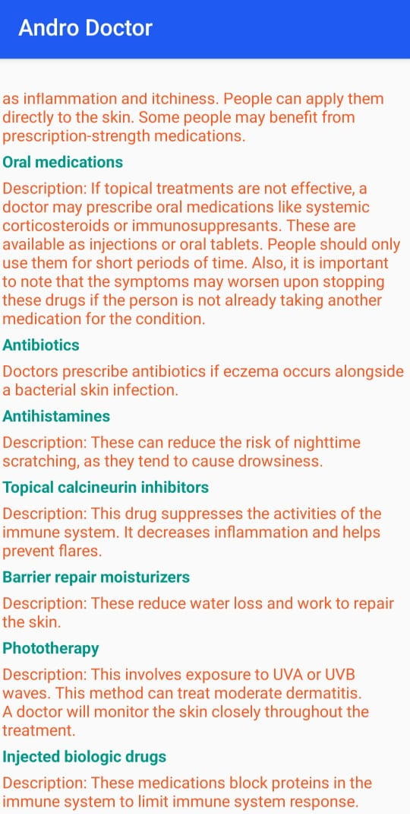
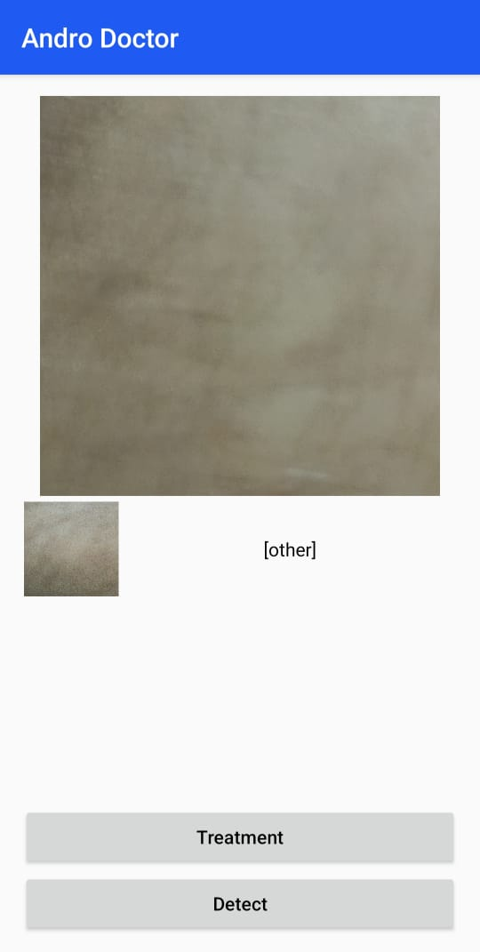

Slide 34
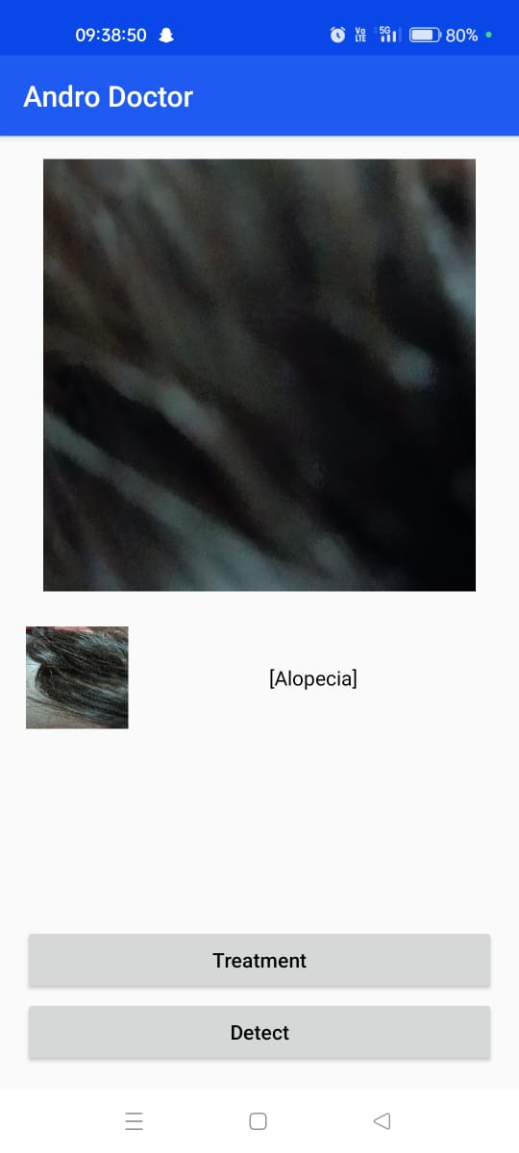
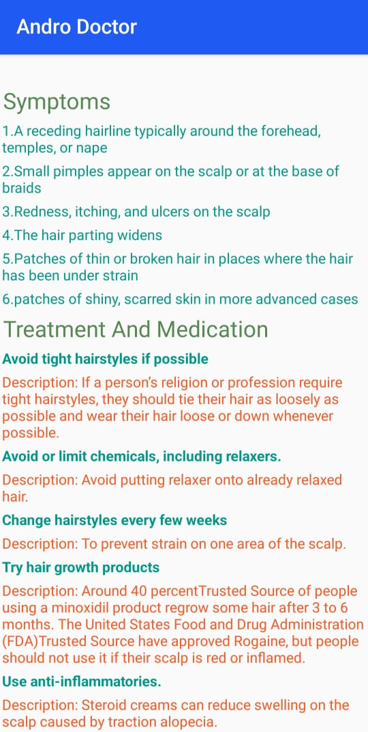
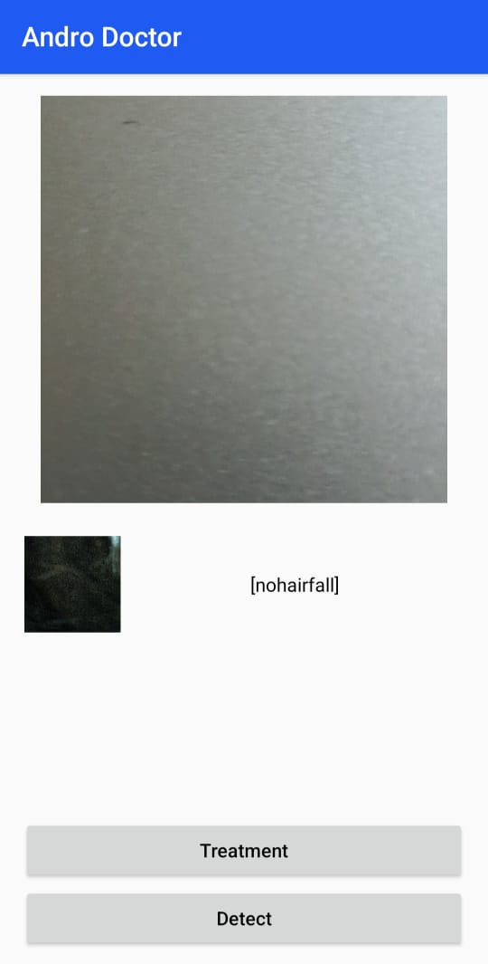

Slide 35
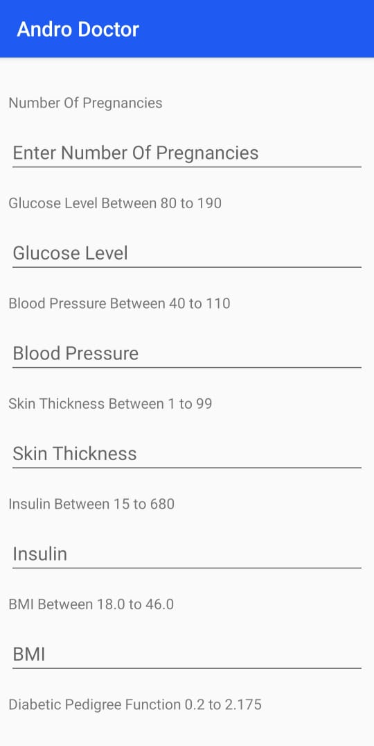
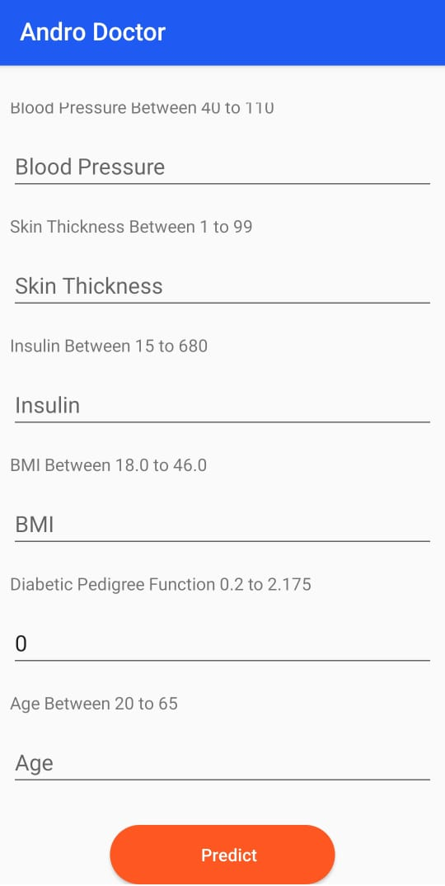

Slide 36
CONCLUSION
This project is regarding an application which collects the medical records of the user like health checkups, blood reports, doctor prescription, laboratory data, billing data etc and retrieves it when it is necessary.Women can also track their monthly periods easily and will be reminded regularly.
Here we are taking three diseases like skin disease, hair fall and diabetic, successfully detected the disease and provide treatment for the detected disease. Hence it is very useful to people’s who are having the problems with above mentioned. It can reduce the user’s time.

